Slide 1
Java Package

Slide 2
Java Package
A java package is a group of similar types of classes, interfaces and sub-packages.
Package in java can be categorized in two form, built-in (pre-defined) package and user-defined package.
There are many built-in (pre-defined) packages such as java, lang, awt, javax, swing, net, io, util, sql etc.

Slide 3
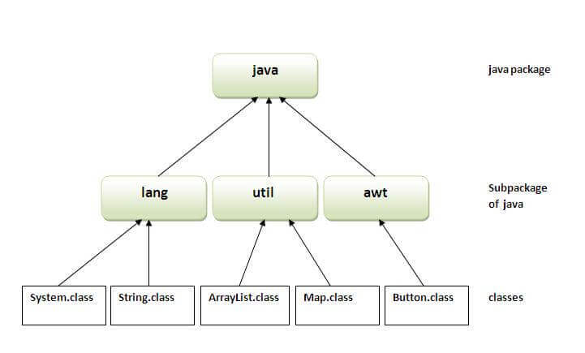
Cont…

Slide 4
Advantage of Java Package
Java package is used to categorize the classes and interfaces so that they can be easily maintained.
Java package provides access protection.
Java package removes naming collision.

Slide 5
Example of java package (User-defined package)
The package keyword is used to create a package in java.
//Simple.java
package mypack;
public class Simple
{
public static void main(String a[])
{
System.out.println("Welcome to package");
}
}

Slide 6
How to compile java package
Syntax
  javac -d directory javafilename.java
For example
  javac -d . Simple.java
The -d is a switch that tells the compiler where to put the .class file i.e. it represents destination. You can use any directory name like d:/abc etc. If you want to keep the package within the same directory, you can use . (dot).

Slide 7
How to run java package program
For example
  java mypack.Simple

Slide 8
How to access package from another package?
There are three ways to access the package from outside the package.
import package.*;
import package.classname;
fully qualified name.

Slide 9
1. Using packagename.*
If you use packagename.* then all the classes and interfaces of this package will be accessible but not subpackages.
The import keyword is used to import the classes and interface of package.

Slide 10
Example
//A.java
package pack;
public class A
{
  public void msg()
  {
  System.out.println("Hello");
  }
}
//B.java
package mypack;
import pack.*;
class B
{
  public static void main(String a[])
  {
    A obj = new A();
    obj.msg();
  }
}
Output: Hello

Slide 11
2. Using packagename.classname
If you import packagename.classname then only declared class of this package will be accessible.

Slide 12
Example
//A.java
package pack;
public class A
{
  public void msg()
  {
  System.out.println("Hello");
  }
}
//B.java
package mypack;
import pack.A;
class B
{
  public static void main(String a[])
  {
    A obj = new A();
    obj.msg();
  }
}
Output: Hello

Slide 13
3. Using fully qualified name
If you use fully qualified name then only declared class of this package will be accessible.
Now there is no need to import. But you need to use fully qualified name every time when you are accessing the class or interface.

Slide 14
Example
//A.java
package pack;
public class A
{
  public void msg()
  {
  System.out.println("Hello");
  }
}
//B.java
package mypack;
class B
{
  public static void main(String a[])
  {
    pack.A obj = new pack.A(); //using fully qualified
    obj.msg();
  }
}
Output: Hello

